Slide 1
RECEPTIONIST CHATBOT
Presented by…
S.Janani,
Department of artificial intelligence and data science,
Sir Issac newton college of engineering and technology.

Slide 2
AGENDA
PROBLEM STATEMENT
PROJECT OVERVIEW
MODELLING AND MY WORK…
RESULTS
SOLUTION AND ITS VALUE PROPOSITION
THE WOWS IN MY SOLUTION
APPLICATION AREAS

Slide 3
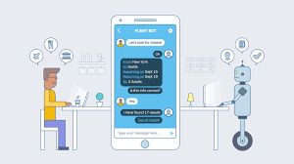
PROJECT TITLE
RECEPTIONIST CHATBOT VIA DEEP LEARNING TECHNIQUES
A receptionist chatbot is an AI-based system designed to interact with users, typically visitors or customers, to provide assistance or information similar to what a human receptionist would offer.

Slide 4
PROBLEM STATEMENT
Chatbots may be limited by predefined rules or patterns.
AI chatbots, while efficient, pose ethical challenges such as privacy, consent, transparency, and accountability.
It's crucial to only collect necessary data and protect it from misuse, with customer consent.
AI chatbots to not only automate customer support, but they also help optimise conversion rates, improve customer experiences, and contribute to direct revenue.
In fact, AI chatbots have helped generate a 60% increase in revenue for e-commerce businesses.

Slide 5
Project overview
Receptionist chatbots have numerous applications across various industries and settings, contributing to improved efficiency, customer satisfaction, and operational effectiveness.
Creating a receptionist chatbot involves leveraging various ,
1. Natural Language Processing (NLP) Libraries
2. Machine Learning Frameworks
3. Chatbot Development Platforms
4. Messaging Platforms and APIs
By leveraging these tools and libraries, developers can build powerful and efficient receptionist chatbots that provide seamless and personalized interactions with users.

Slide 6
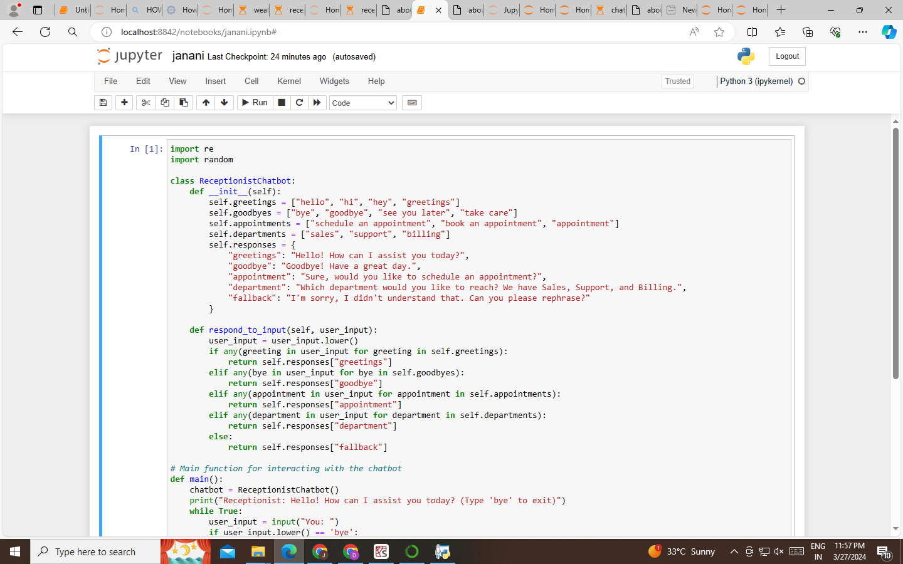
MY WORK….
Here I have done my work in the above mentioned topic let’s make a sight on it ….

Slide 7
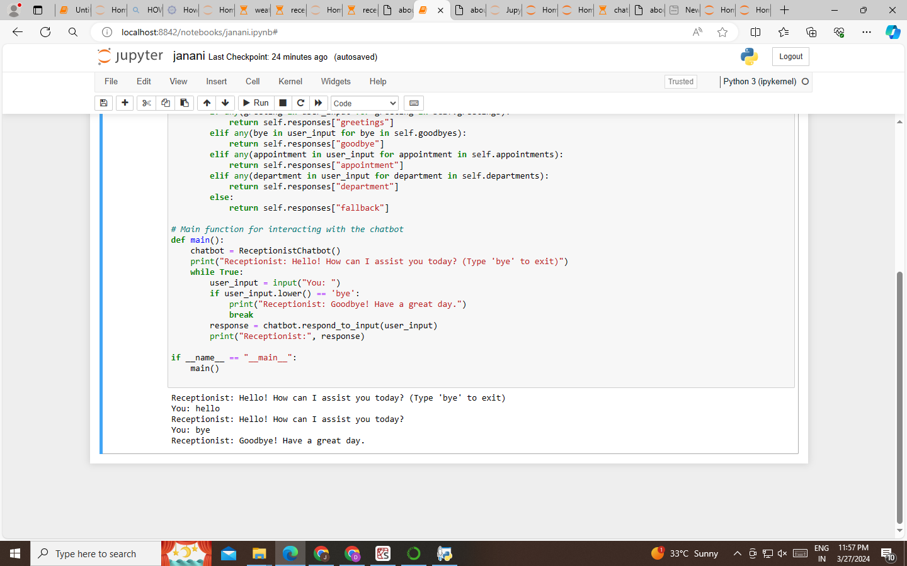

Slide 8
Solution and its value proposition
A simple chatbot answering all the questions of a patient,customer,anyone for their needs.
They can identify the emotions and feelings expressed in terms of their of words provided by the users.
They are human like repliers which answers all our needs according tom our questions.
Nearly 70% of our queries can be answered…
They are highly contribute towards various fields such as manufacturing, trade, medicine, etc….

Slide 9
The wows in my solution…
By leveraging cutting-edge artificial intelligence and natural language processing technologies, our chatbot aims to transform traditional receptionist roles and deliver an unparalleled experience to our visitors and customers.
Our chatbot will be available round the clock, ensuring that visitors can access assistance and information at any time, regardless of office hours.
Appointment Scheduling
Enhanced User Experience
Cost Savings
Resource Optimization
Continuous Improvement

Slide 10
Application areas
Receptionist chatbots have numerous applications across various industries and settings.
Here are some key application areas of receptionist chatbots:
1. Corporate Offices and Business Centers
2. Hotels and Hospitality
3. Healthcare Facilities
4. Educational Institutions.
5. Retail and Shopping
6.Government Offices and Public Services

Slide 11
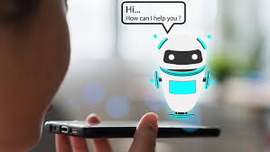
THANK YOU!!

